Slide 1


CPRM - Key System Interfaces
Welcome to the presentation on the CPRM system. We will explore its key interfaces, focusing on secure access, dynamic display management, and comprehensive technician controls. This overview highlights the system's efficiency and user-centric design.
by 928 Gauresh

Slide 2
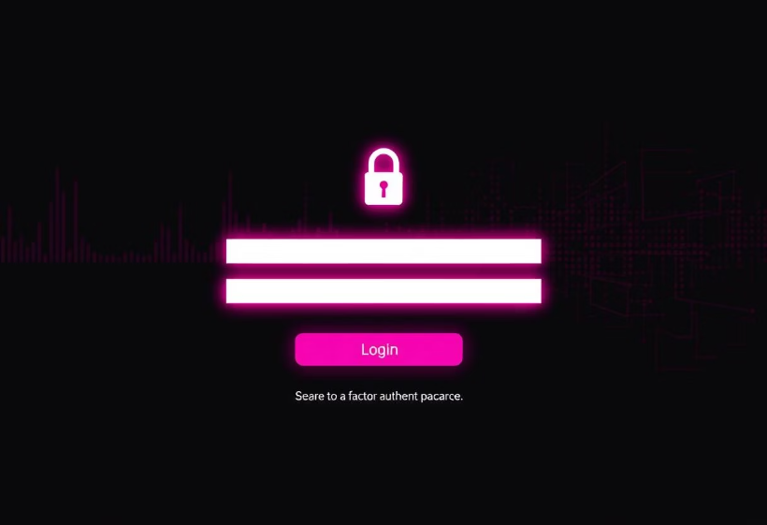
Secure Access: CPRM Login Interface
Role-based authentication system for secure access
Demo credential access for testing environments
Advanced security features and protocols
Intuitive user experience considerations

Slide 3
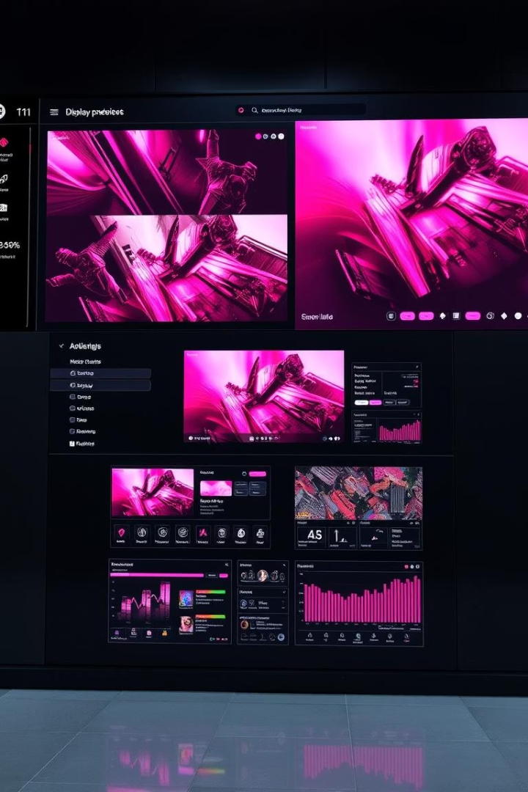




Dynamic Display System: Individual Screen Management
Real-time Content Management
Update individual displays instantly
Status Monitoring
Diagnostics and system health at a glance
Content Scheduling
Pre-plan content for specific times
Emergency Integration
Seamless emergency broadcast features

Slide 4
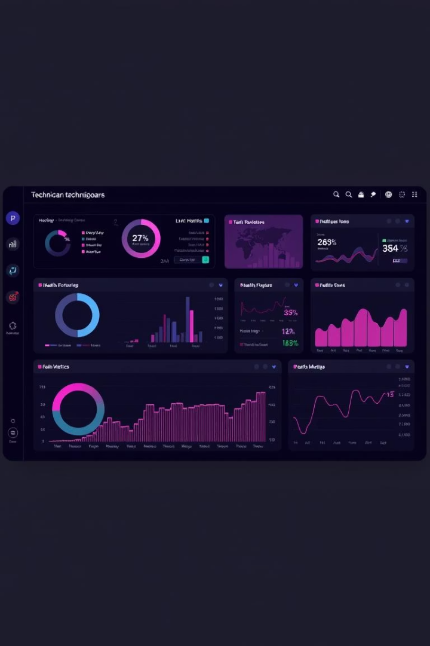
System Control: Technician Interface
System Health Monitoring
Operating Theater Tracking
Comprehensive overview of system status
Monitor maintenance schedules effectively
Emergency Alert Management
Respond to critical alerts promptly

Slide 5
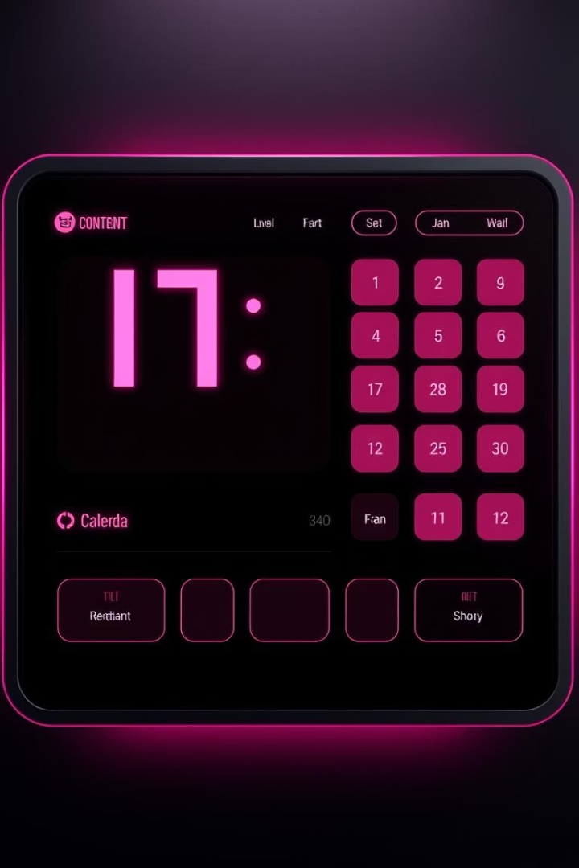




Content Scheduling Capabilities
Define Playlists
Group content for specific needs
Set Schedules
Automate content delivery times
Real-time Updates
Adjust on the fly as needed
Performance Tracking
Analyze content effectiveness

Slide 6





Security Features and Protocols
Data Encryption
Multi-Factor Authentication
Threat Detection
Proactive security monitoring
End-to-end data protection
Enhanced login security
Compliance Audits
Adherence to industry standards

Slide 7
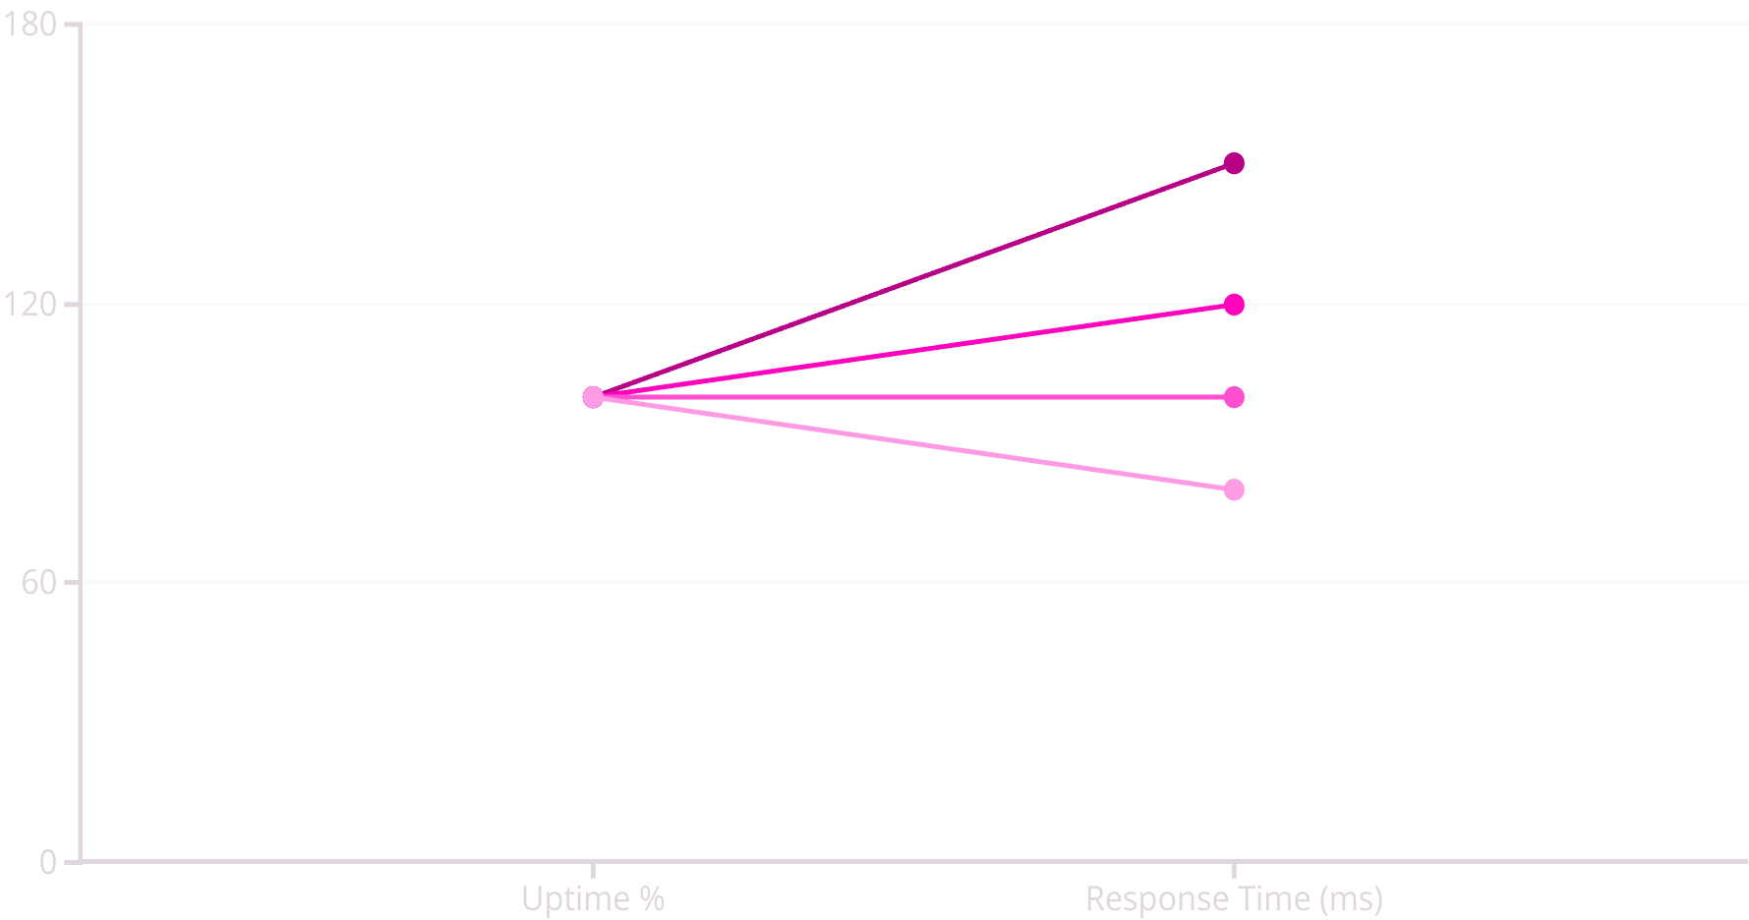
Performance Analytics and Metrics
Q1
Q2
Q3
Q4
Our system performance has steadily improved, with uptime consistently increasing and response times decreasing across all quarters. This demonstrates the stability and efficiency of the CPRM platform, ensuring reliable operations.

Slide 8

Thank You
Thank you for your time and attention. We appreciate your interest in the CPRM system and its capabilities.
Contact Information
Project Repository
Email: info@cprmsolutions.com
Website: cprmsolutions.com

